Slide 1
RecBench: Benchmarks for Evaluating Performance of Recommender System Architectures
Michael D. Ekstrand
Michael J. Ludwig
Ahmed Eldawy
Mohamed F. Mokbel
John T. Riedl
Justin Levandoski

Slide 2
Outline
Overview of recommender systems
RecBench motivation
RecBench benchmark tasks
Recommender system architectures
RecBench experimental results
Conclusion

Slide 3
Outline
Overview of recommender systems
RecBench Motivation
RecBench benchmark tasks
Recommender system architectures
RecBench experimental results
Conclusion

Slide 4
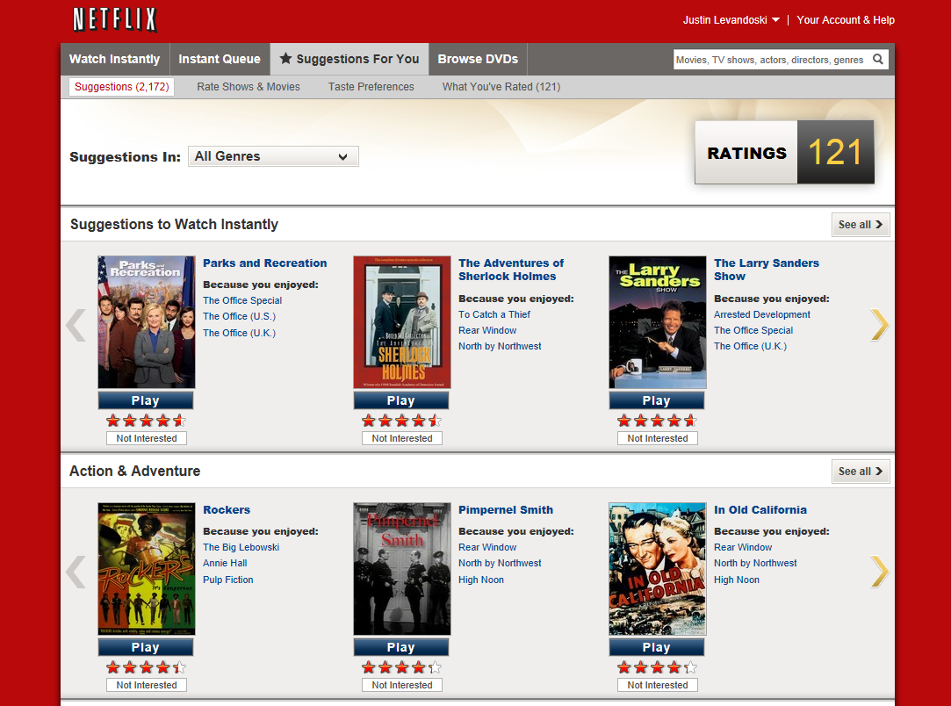
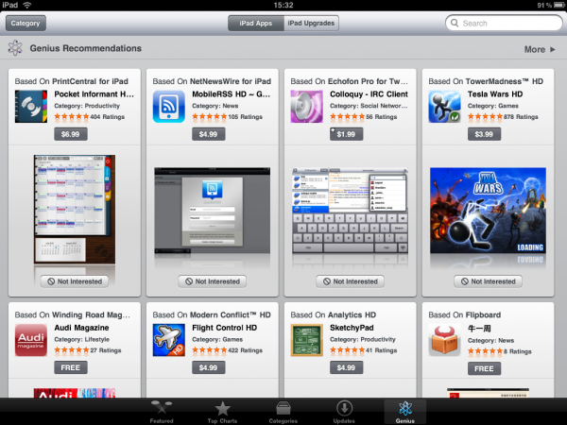
Recommender Systems – Basic Idea
Users: provide opinions on items consumed/watched/listened to…
The system: provides the user personalized suggestions for new items
Notes:
The basic idea of a recommender systems is to gather user opinions/behavior and analyze this information to provide personalized suggestions (recommendations) to individual users
Examples:
Most prominent example is Netflix (users watch movies, provide ratings, netflix provides movie recommendations)
Amazon for books and other products (mix of purchase history and ratings)
Apple iTunes store: apps, TV shows, music

Slide 5
Collaborative Filtering (CF)
?
?
?
Notes:
To make this concrete, I will discuss one specific method for producing recommendations, which is item-based CF. Item-based CF is the specific technique we use in our experiments in the paper.
Want to emphasize two things:
item-based CF is just one of many ways to produce recommendations, we use it in this work as it is popular and used extensively in practice
The benchmark tasks that we will see shortly are in no way tied to a specific recommendation method
[set up item-based CF example with users/movies]

Slide 6
Item-Based CF Model Building
Similarity measures
Cosine distance
Pearson correlation
Spearman correlation
Adjusted cosine distance
. . .
m1
m2
m3
 | .8
 | .6
 | .5
 | .3
,
,
,
similarity(m1,m3)
similarity(m1,m2)
 | .9
 | .8
 | .5
 | .4
,
,
,
 | .7
 | .6
 | .5
 | .4
,
,
,
. . .

Slide 7
Item-Based CF Recommendations
 | .8
 | .6
 | .5
 | .3
,
,
,
 | .9
 | .8
 | .5
 | .4
,
,
,
 | .7
 | .6
 | .5
 | .4
,
,
,
 | .9
 | .6
 | .5
 | .5
,
,
,
 | .7
 | .6
 | .5
 | .3
,
,
,

Slide 8
Item-Based CF Recommendation
(
 | .8
+
 | .6
)
/
(.8 + .6)
X 2
X 4
= 2.86
(
 | .9
+
 | .5
)
/
(.9 + .5)
X 2
X 4
= 2.71
(
)
/
(.7 + .5)
 | .7
X 4
+
 | .5
X 2
= 3.17

Slide 9
Outline
Overview of recommender systems
RecBench Motivation
RecBench benchmark tasks
Recommender system architectures
RecBench experimental results
Conclusion

Slide 10
RecBench Motivation
Traditionally, recommender systems = customized software
Example: Movielens
Can we use relational DBMS primitives to build a recommender?
No work has explored recommender system performance
Performance has always been synonymous with “quality”
“We have chosen not to discuss computation performance of recommender algorithms. Such performance is certainly important, and in the future we expect there to be work on the quality of time-limited and memory-limited recommendations.”
“[Our] solution is based on a huge amount of models and predictors which would not be practical as part of a commercial recommender system. However, this result is a direct consequence of the nature and goal of the competition: obtain the highest possible accuracy at any cost, disregarding completely the complexity of the solution and the execution performance."
Team BelKor’s Pragmatic Chaos
Winner of the 2009 Netflix Prize
Herlocker et al. “Evaluating Collaborative Filtering Recommender Systems”, ACM TOIS 2004
Notes:
Almost all recommender systems we have come across have been customized pieces of software used for a specific purpose
One good example of this is MovieLens built a the university of Minnesota (for those not familiar, this was an early research prototype…)
Built entirely in java, uses DBMS as a persistent store for ratings
No work in the literature that we are aware of has tested recommender system performance
Performance has been synonymous with recommendation “quality”
Two quotes from prominent work in the recommender system community help highlight this fact

Slide 11
RecBench Motivation
Goals of RecBench:
Prompt research community to explore space of alternative architectures for building recommender systems and study their performance
Propose a benchmark to test performance (efficiency) of different system architectures

Slide 12
Outline
Overview of recommender systems
RecBench Motivation
RecBench benchmark tasks
Recommender system architectures
RecBench experimental results
Conclusion

Slide 13
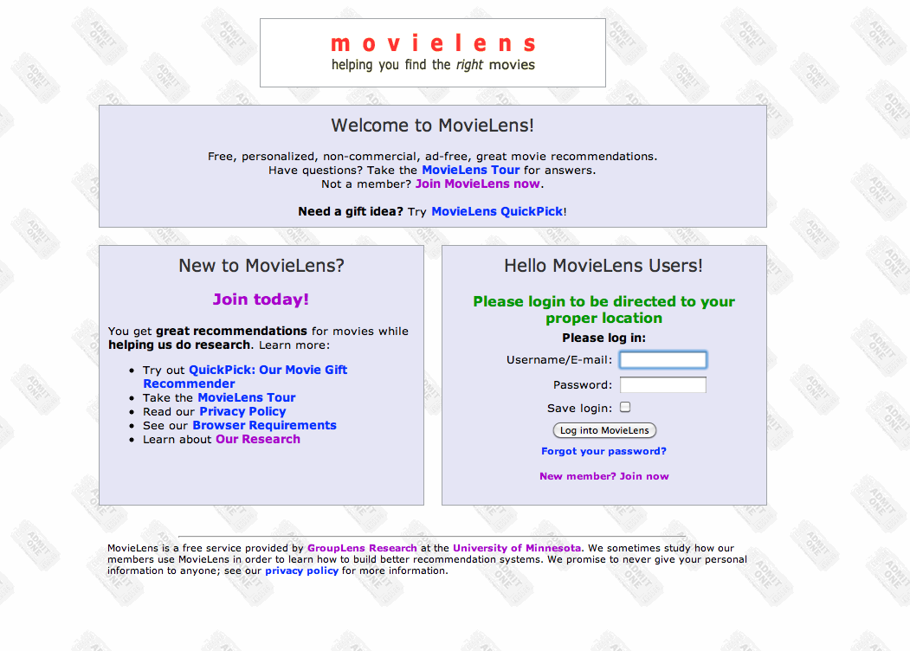
RecBench Tasks
http://www.movielens.org

Slide 14
Task 1: Initialization
Initialization Task
Prepare system to start serving user recommendations
Stored
Recommendation Model
Notes:
Objective of this task is to prepare the system for “live use”
For most systems, initialization will mean building the recommender model. This is usually an offline task.

Slide 15
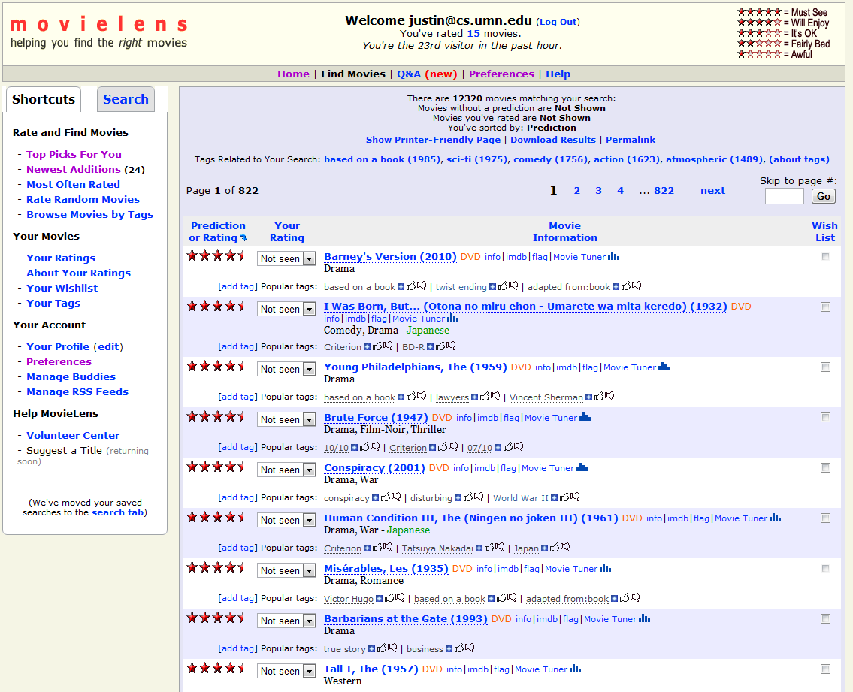
Task 2: Pure Recommend
Pure Recommend Task
Produce top-k recommendations from system’s entire item pool
Notes:
This task simulates a user navigating to an e-commerce site (e.g., Netflix, movielens), where they receive a set of recommendations from the system on a home page.
The objective of this task is to produce for the user a set of n recommended items.
This tasks tests the system efficiency in executing the common top-n recommendation process.

Slide 16
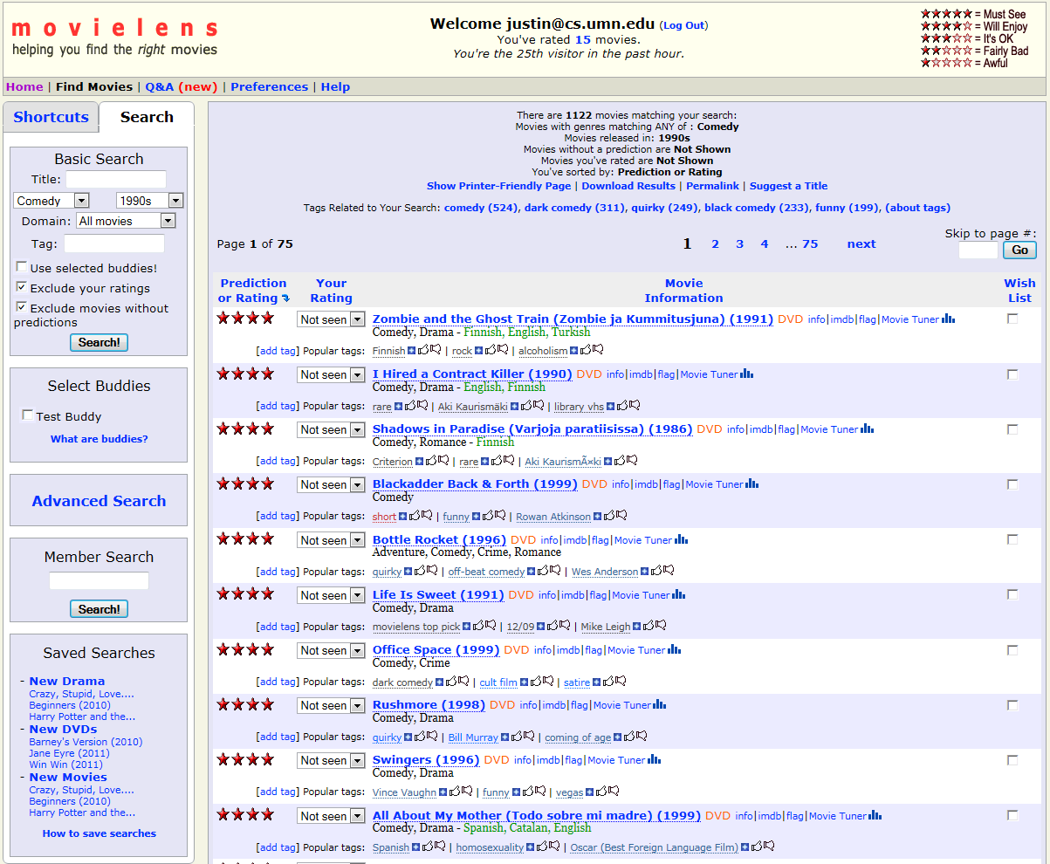
Task 3: Filtered Recommend
Filtered Recommend Task
Produce top-k recommendations that match constraints on item metadata
Notes:
This task models the user requesting recommendations for only a specific set of items (e.g., comedy movies released after 1990).
The objective of this task is to produce a set of n recommended items that match one or more constraints placed on the item metadata (e.g., movie year).
This task tests the system efficiency in querying item metadata and producing a set of top-k filtered recommendations.

Slide 17
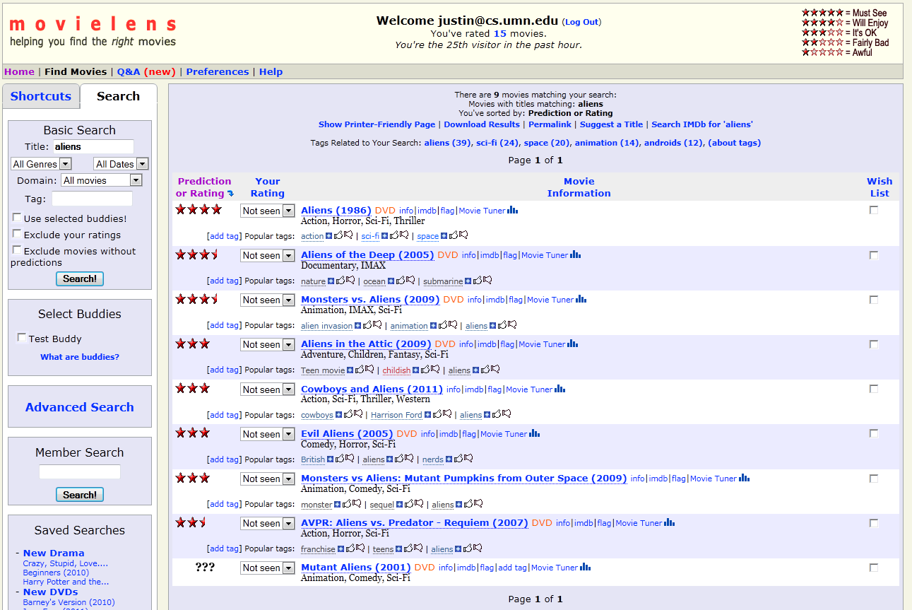
Task 4: Blended Recommend
Blended Recommend Task
Produce top-k recommendations based on blended text-search and recommendation score
Notes:
This task models our system user requesting recommendations based on a free-text search.
The objective of this task is to produce a set of n recommended items using the average of the item recommendation score and text-search score.
This task tests the system’s ability to efficiently incorporate IR-based scoring techniques into its recommendation process.

Slide 18
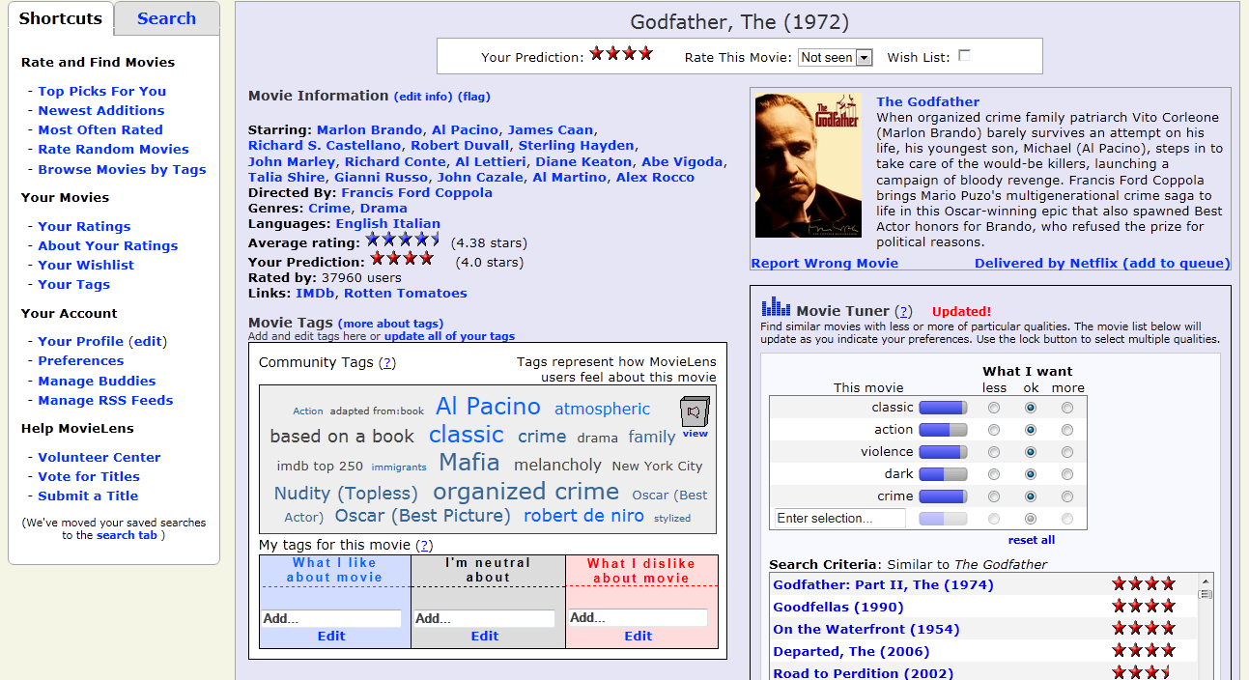
Task 5: Item Prediction
Item Prediction
Generate a user’s predicted rating for a target item
Notes:
This task models our system user navigating to a specific target item (e.g., movie, book), whereby the recommender system gauges the user’s interest in the item.
The objective of this task is to generate the user’s predicted rating for the target item.
This task tests the system performance in producing predictions for a single item.

Slide 19
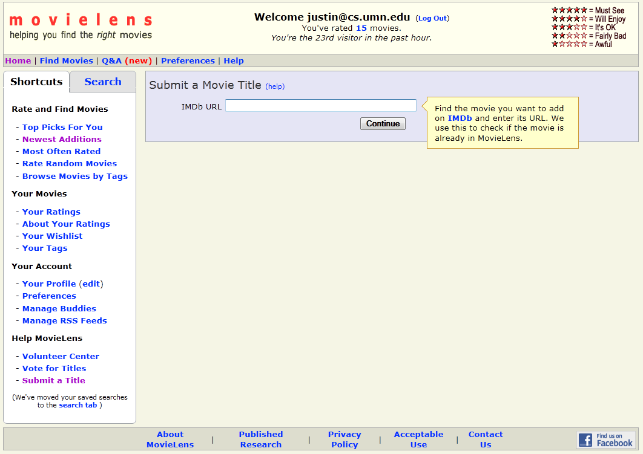
Task 6: Item Update
Item Update
Incorporate new item(s) into the system for recommendation
Notes:
This task models a new item being added to the system.
The objective of this task is to get the item into circulation as a recommendation candidate as soon as possible after users start rating it or customers start buying it.
For most systems, this task will require incorporating the item’s ratings or purchase history into the recommender model built originally by the initialization task.

Slide 20
Outline
Overview of recommender systems
RecBench Motivation
RecBench benchmark tasks
Recommender system architectures
RecBench experimental results
Conclusion

Slide 21
Recommender System Architectures
MultiLens
Unmodified DBMS
RecStore DBMS
PostgreSQL database
Ratings relation: ratings(usr,itm,rating) Model relation: model(itm, rel_itm, sim)
All tasks implemented in standard SQL (details in paper)
Metadata and text-search functionality “built in” (e.g., selection)
Database modified to optimize for fast recommender model updates
SQL same as unmodified DBMS approach
Maintain partial statistics to update rec. model incrementally as new ratings arrive
“Hand-built” system
UMN recommender software suite (basis for MovieLens)
Code optimized for item-based CF
Uses DBMS for metadata and text-search queries
Notes:
MultiLens/Hand-Built
Flexibility: harder to implement non-trivial changes to recommender systems, e.g., add filtering techniques
Query processing: “lean and mean”, customized code tailored to recommendation task
Domain-specific optimizations such as customized in-memory data structures and recommendation generation algorithms
Drawbacks when data must go to disk (re-implement disk-based algorithms or rely on virtual paging)
DBMS-based approach
Flexibility: almost trivial to add functionality such as selection, etc.
Query processing:
Advantage: leverage query processor to find near-optimal plan, indexing, scale to out-of-memory-sized data sets
Disadvantage: if most operations are memory-based, non-trivial book-keeping overhead compared to hand-built approach

Slide 22
Outline
Overview of recommender systems
RecBench Motivation
RecBench benchmark tasks
Recommender system architectures
RecBench experimental results
Conclusion

Slide 23
Benchmark Setup
Datasets
MovieLens
10M movie ratings
~10K movies, ~70K users
Netflix Challenge
100M movie ratings
~18K movies, ~480K users
Architectures
Metric
Metric is response time
For recommendation queries, time is average of sample of 2.5% of total users broken down by quartile
Same timing/sampling technique used for items for prediction task
MultiLens
Unmodified DBMS
RecStore DBMS
Tasks
Item-based collaborative filtering used as recommendation technique
Tasks implemented specific to data from movie domain
Run on 4-way 3 GHz Intel Xeon system with 48 GB or RAM

Slide 24
Task 1: Initialization
Task 1: build collaborative filtering model using movie ratings
MovieLens 10M
Netflix 100M

Slide 25
Task 2: Pure Recommend
Task 2: retrieve k recommendations using all possible movies
MovieLens 10M
Netflix 100M

Slide 26
Task 3: Filtered Recommend
Task 3: retrieve k recommendations of only 1990s comedies
MovieLens 10M
Netflix 100M

Slide 27
Outline
Overview of recommender systems
RecBench benchmark tasks
Recommender system architectures
RecBench experimental results
Conclusion

Slide 28
Future Work
Just scratched the surface on recommender system architecture and performance work
More performance studies
Multi-user experiments
Different recommendation techniques
Recommender system architectures
Hybrid systems
Recommendation-specific operators [Koutrika et al, SIGMOD09]

Slide 29
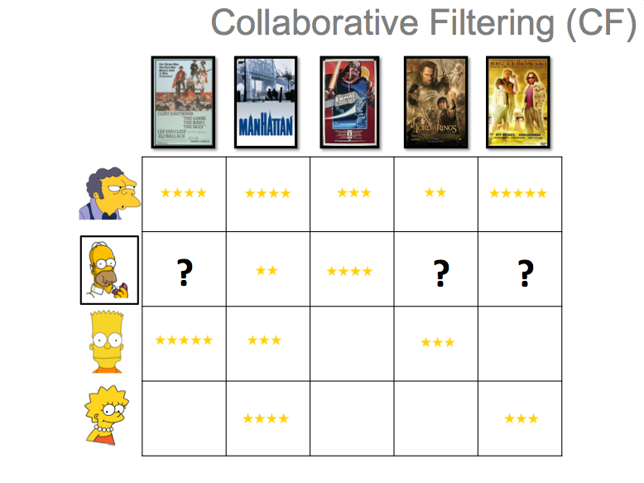
Conclusion and Summary

Slide 30
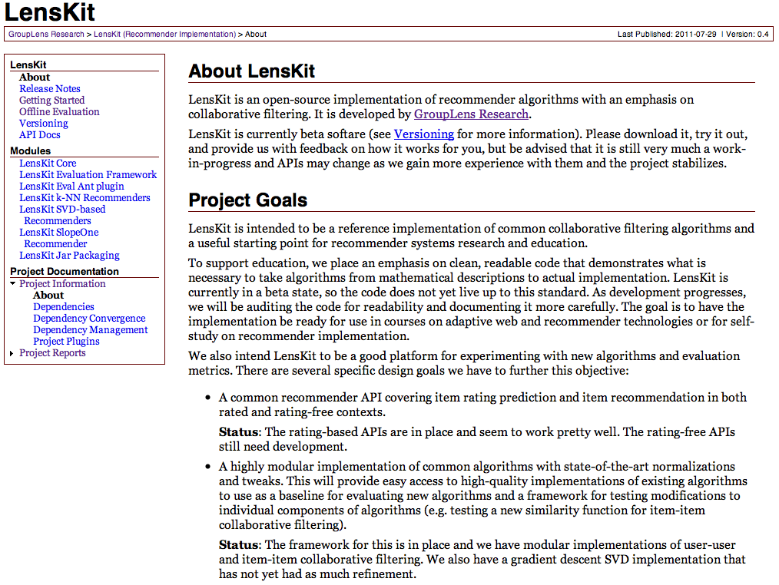
http://lenskit.grouplens.org
Recbench available as part of LensKit project from University of Minnesota

Slide 31
Questions?

